Slide 1
Project “AARTHI”

Slide 2
Project Details
Agenda:
Mission is to Empower , Educate , Engage youth Touching them in every Area of Life.
Vision:
Aarthi project mainly focus and work for girl child education in various forms. This project focuses attention on the need to address the challenges girls face and to promote girls' empowerment and the fulfillment of their human rights. LHO is committed to ensure that all girls have access to quality education and a dignified life.

Slide 3
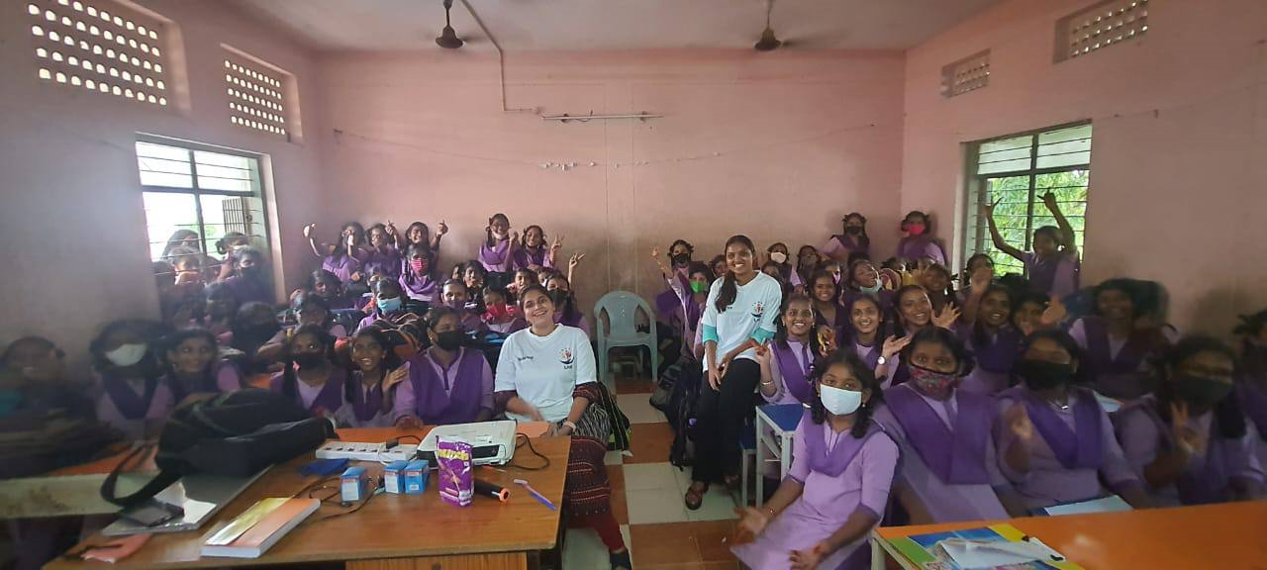
Personal Hygiene
Financial Independence
Self Defense
AARTHI
Importance of Mental Health
Technical Skills
Menstrual Hygiene
Notes:
You can safely remove this slide. This slide design was provided by SlideModel.com – You can download more templates, shapes and elements for PowerPoint from http://slidemodel.com/

Slide 4
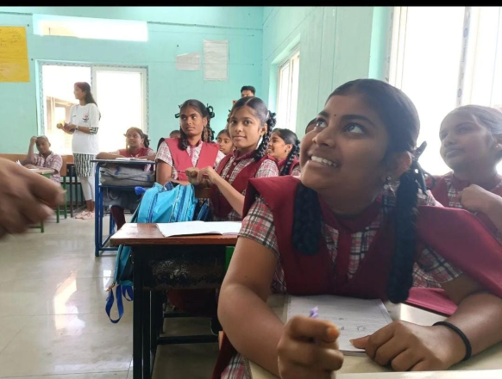
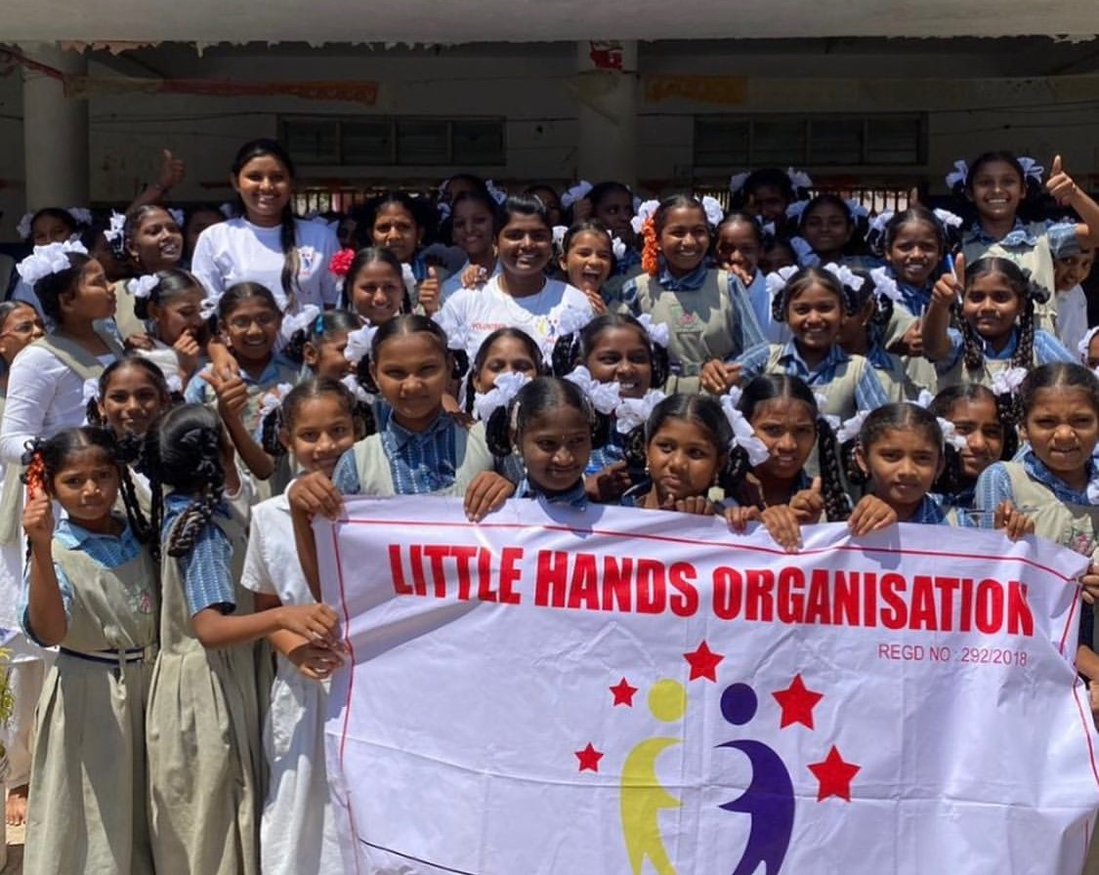
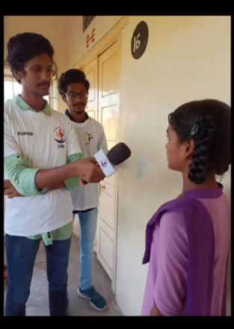
Every Girl right is to get good health and Education

Slide 5
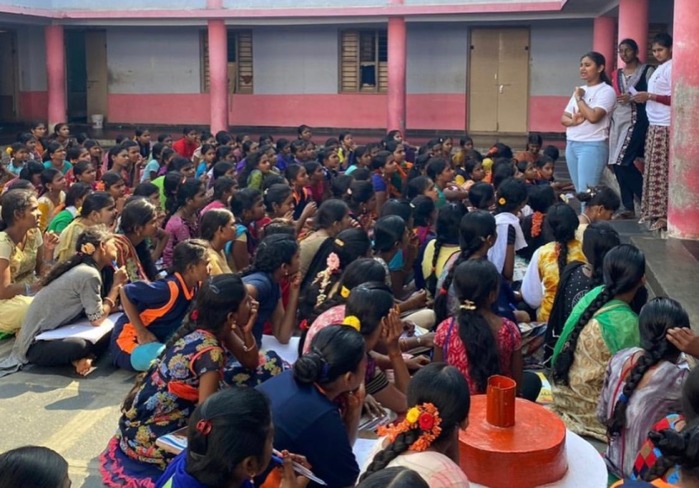
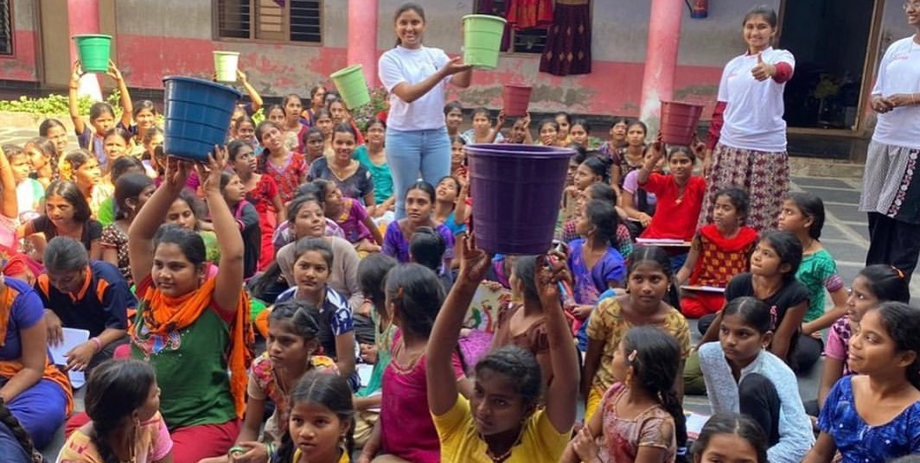
The first event of this project was conducted in LHO hometown Narasaraopet at Kasturba girls hostel.
We LHO Team has done menstrual hygiene and awareness session and followed by dustbins distribution.

Slide 6
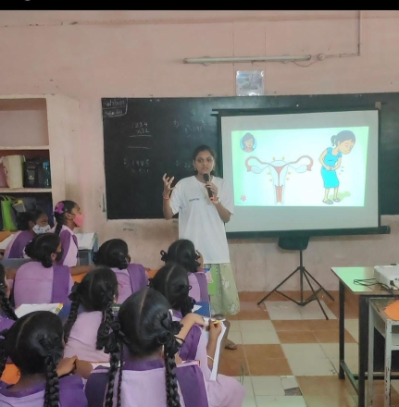
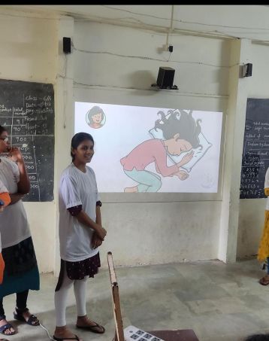
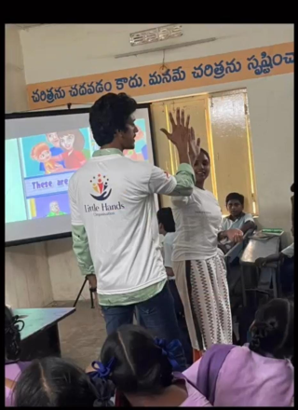
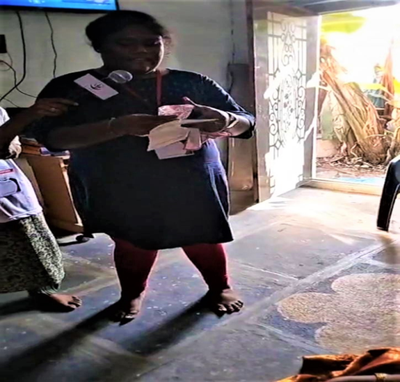
We have taught them following things:
What is Menstruation?
What nutrients should eat during periods?
How to take care during menstrual period?
How to use pad and dispose it?
What is PCOD and PCOS?

Slide 7
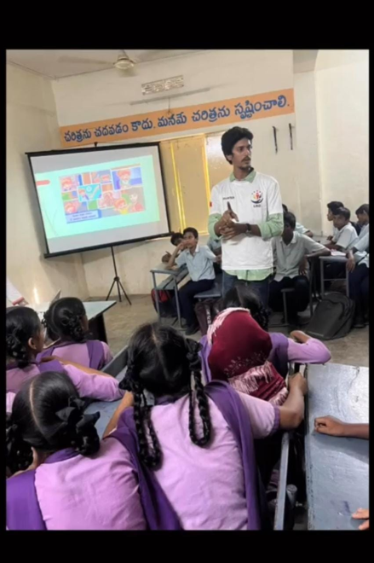
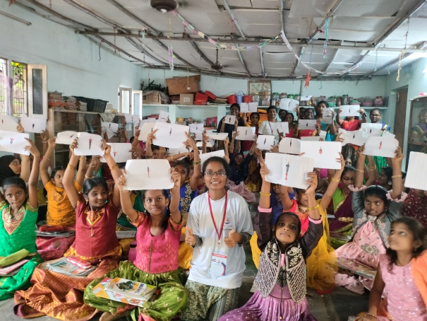
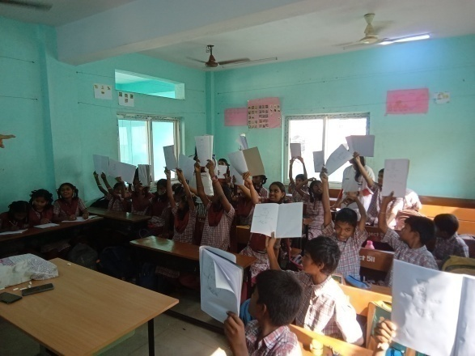
We have conducted some activities to make sure to understand the topics.

Slide 8
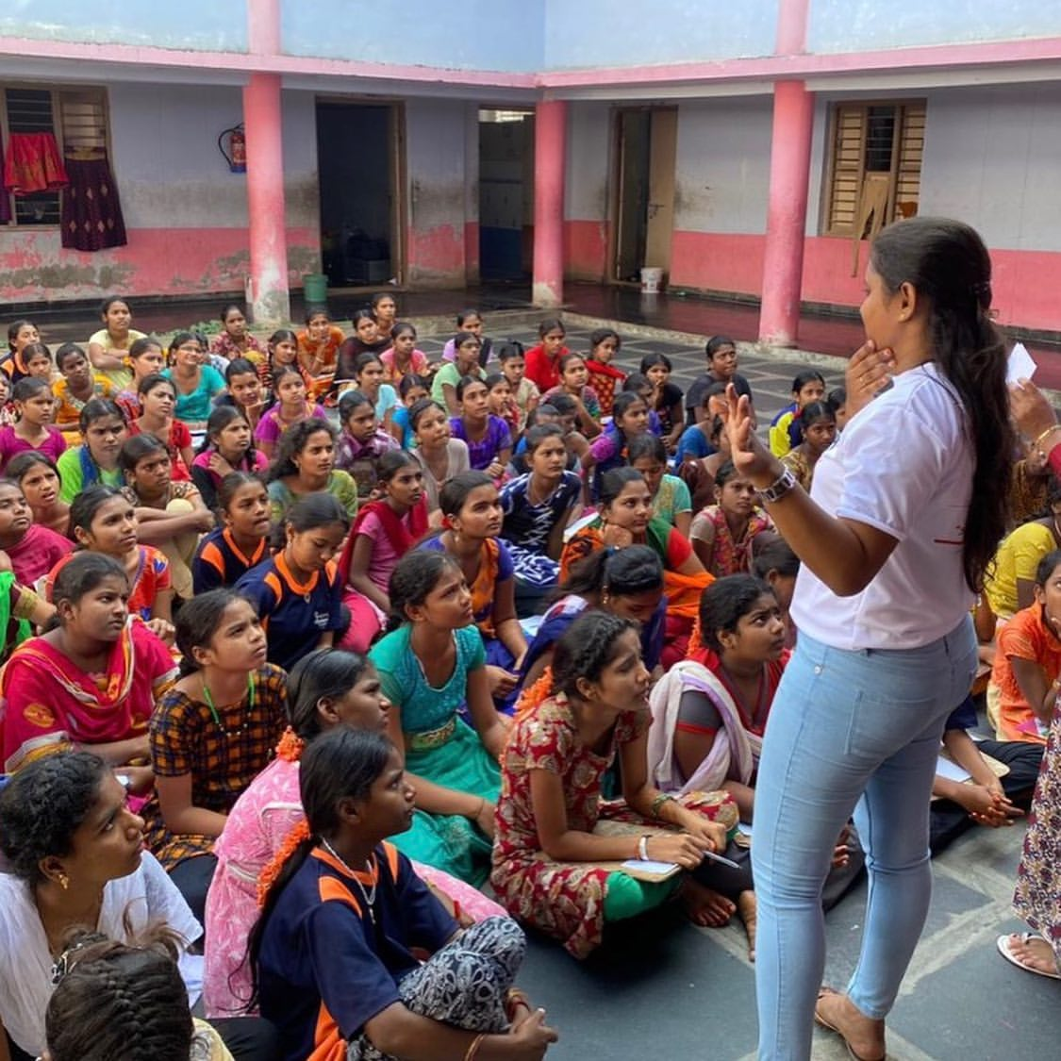
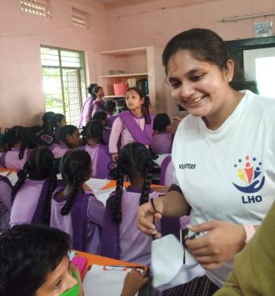
Awareness reduces Mental illness
Awareness reduces Negative thoughts

Slide 9
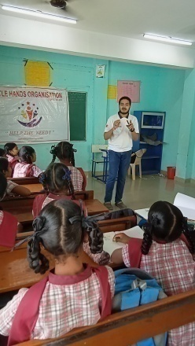
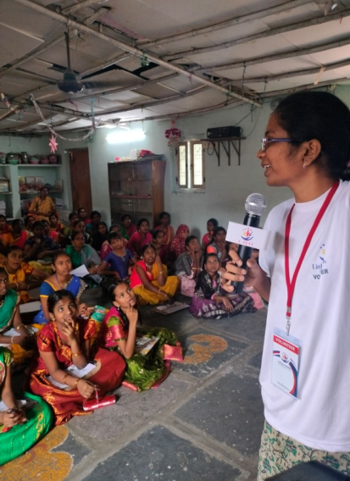
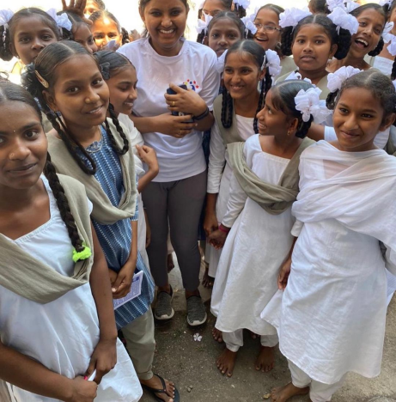
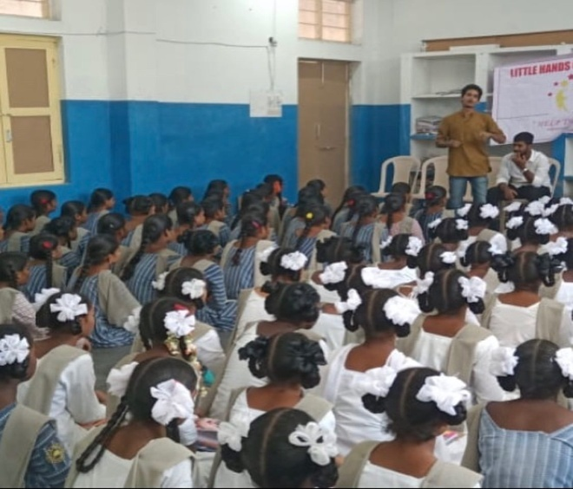
We have created impact on 15+ schools in different regions.

Slide 10
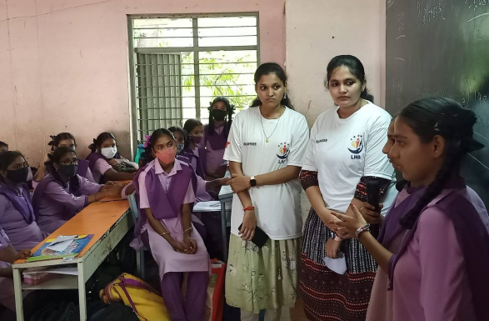
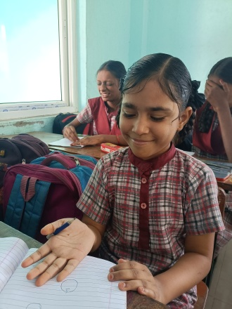
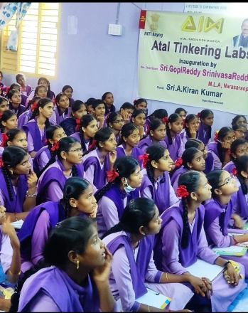
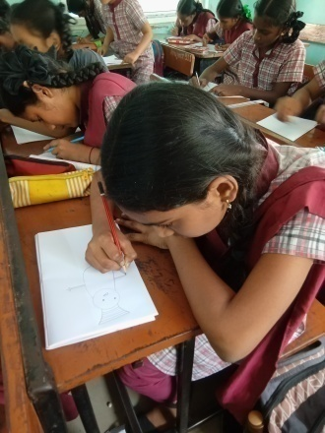
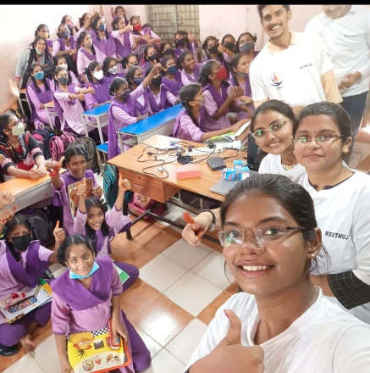
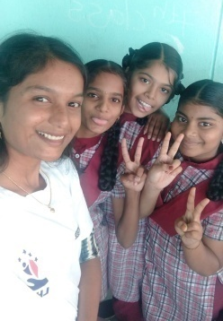
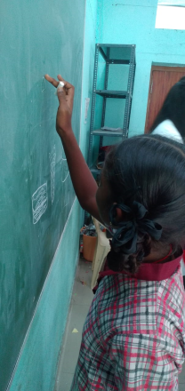
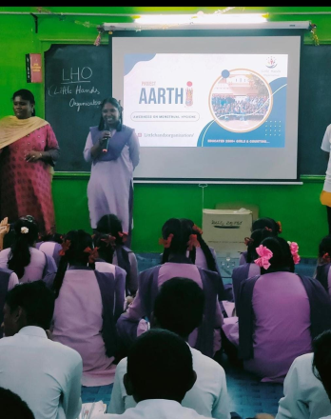

Slide 11
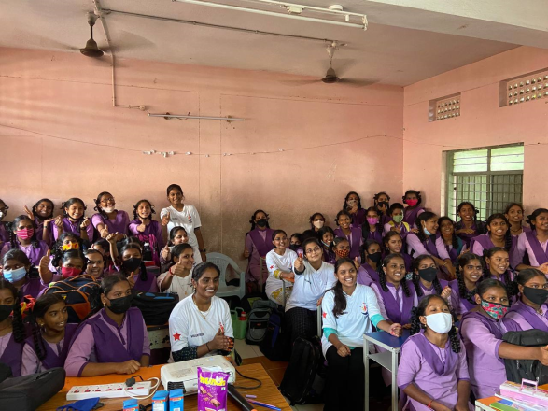
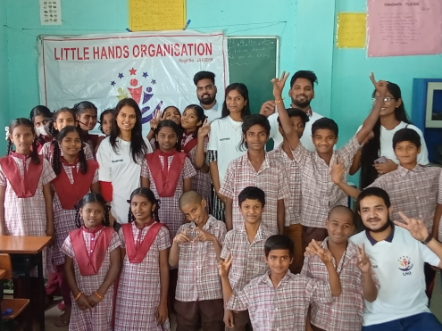
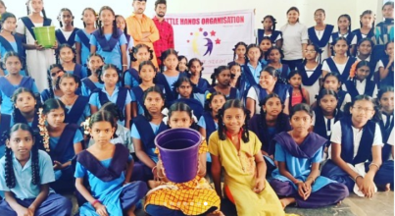
Till date through AARTHI project we have educated 3500+ children in different schools.
By end of 2023 our goal is to reach 10,000 children who will be trained under Project *AARTHI*.

Slide 12
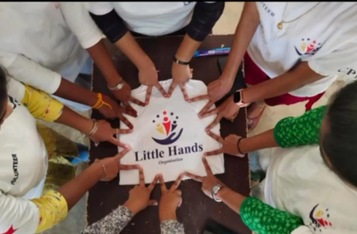
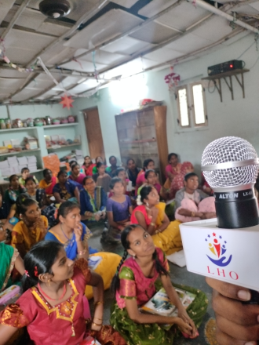
THANK YOU

